Slide 1
Azure Cloudcamp
Juan Carlos Ruiz

Slide 2
IAC Infraestructura como Servicio
Notes:
Slide Objectives:
Explain how Azure helps developers to refocus on their applications.
Speaker Notes:
Before we discuss about specifics, let’s refocus on what you care about – your application/service.
Azure is taking a application-centric approach and brings tools and services to support DevOps scenarios.

Slide 3
→ Su código de aplicación
→ Los recursos que se requieren
→ Su código de infraestructura
Notes:
Slide Objectives:
Explain application is made up by application code and infrastructure code.
Speaker Notes:
Let’s start with something that you know inside-and-out: your application code. [click]
Then, for whatever reason, you decide to deploy your application to Azure. [click]
What you do is to allocate a bunch of related resources out of the humongous resource pool provided by Azure, deploy your application code to these resources, and you have a running service. [click]
For DevOps’ perspective, you need a way to reliable capture and apply your requirements on resources, which can be referred as infrastructure code.

Slide 4
Usted: Codigo (aplicacion, infraestructura)
Azure: Recursos (IaaS, PaaS, SaaS)
Notes:
Slide Objectives:
Reiterate the point that to make your service successful, you are partnering with Azure. You bring the code, and Azure brings resources.
This slide also sets state for the talk by explaining how IaaS components fit into the overall picture.
Speaker Notes:
[Continue with previous slide]
To make your service successful, you are partnering with Azure. You bring the code, and Azure brings resources. [Click]
And you keep iterating and making improvements over time. [Click]
In terms of infrastructure code, you can use it to define desired states of required resources (Note: current Azure Resource Manager only support a small number of Resource Providers). [Click]
You can define hosting environments, such as websites, cloud services and VMs. [Click]
Required services. [Click]
In this session we’ll focus on infrastructural components including virtual machines and virtual networks.

Slide 5
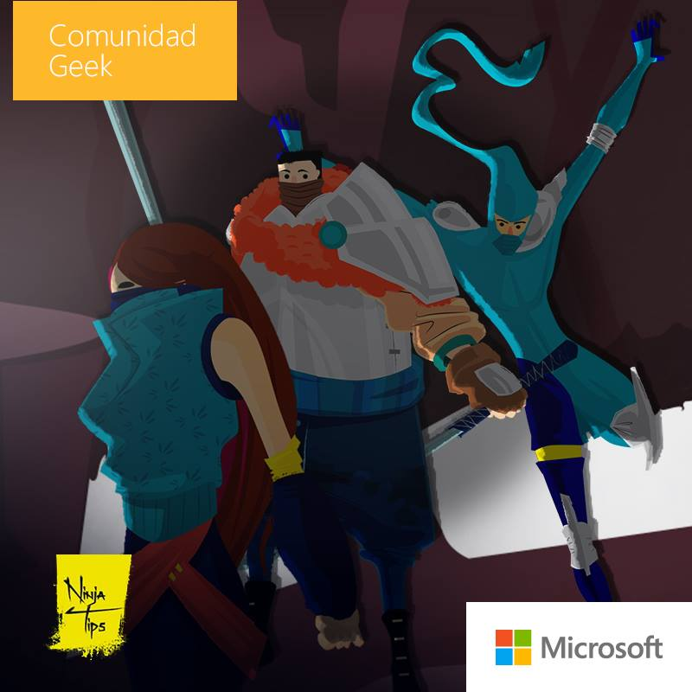
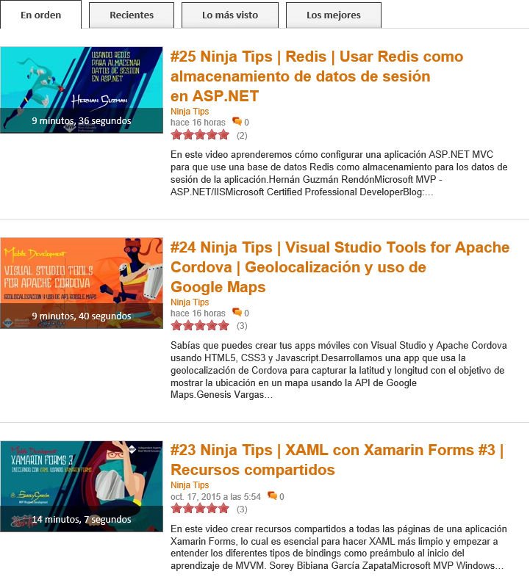

Ninja Tips - http://jkr.im/Ninja-Tips

Slide 6






Contacto
Juan Carlos Ruiz
SR Technical Evangelist
@JuanKRuiz
JuanKDev
http://juank.io
JuanKSolocodigo

